Slide 1
Lipophilicity and translocation of (non-)ionised chemicals in intact plants - one curve fits all?
Uptake via roots
Carola Schriever ⁽¹⁾, Marc Lamshoeft ⁽²⁾
(1) BASF SE, (2) Bayer AG E-mail contact: carola.schriever@basf.com

Slide 2
Overview
Why this question?
Our approach
The results
Our conclusion
An outlook

Slide 3
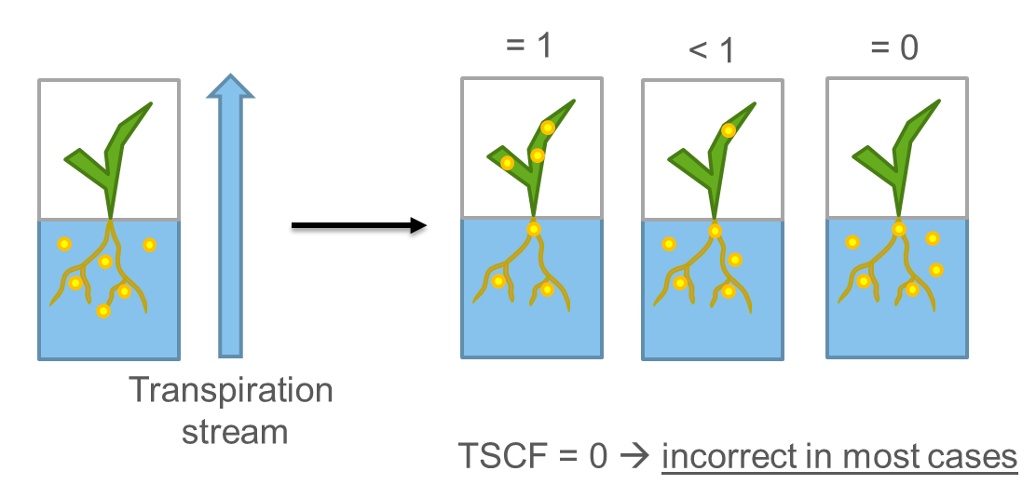
Introduction
A lot of peer-reviewed studies link observed root uptake and translocation to lipophilicity of compounds
OECD guideline development ongoing: see Poster XYZ
Root uptake and translocation are described by the Transpiration Stream Concentration Factor (TSCF)

Slide 4
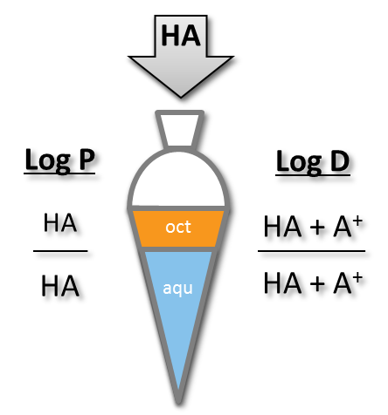
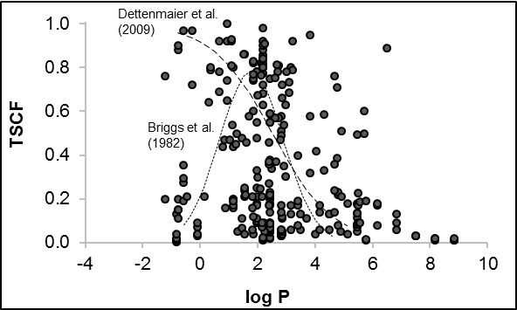
Introduction
Lipophilicity is expressed by log P (log Kow of non-ionised molecule species)
Different curves proposed to describe the relationship
Quite some variability linking log P and experimental TSCF (pH) (Doucette et al., 2018)
Log P - partition coefficient
non-ionised species of a compound
Log D - distribution coefficient
equal to log P for non-ionisable compounds
pH-dependent for ionisable compounds
Briggs, G.G., Bromilow, R.H., Evans, A.A., 1982. Relationships between lipophilicity and root uptake and translocation of non-ionized chemicals by barley. Pestic. Sci. 13 (5), 495–504.
Dettenmaier, E.M., Doucette, W.J., Bugbee, B., 2009. Chemical hydrophobicity and uptake by plant roots. Environ. Sci. Technol. 43, 324–329.
Doucette,W.J., Shunthirasingham, C., Dettenmaier, E.M., Zaleski, R.T., Fantke, P., Arnot, J.A., 2018. A review of measured bioaccumulation data on terrestrial plants for organic chemicals: metrics, variability, and the need for standardized measurement protocol. Environ. Toxicol. Chem. 37 (1), 21–33.

Slide 5
Research questions
Can log D help to reduce the observed variability?
Which relationship exists between log D and TSCF?
Can a simple mathematical model describe the relationship?

Slide 6
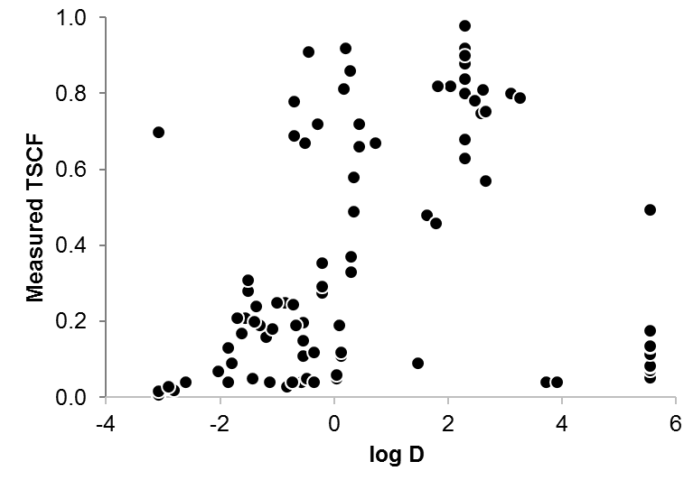
Data set
Experimental TSCF values papers reviewed by Doucette et al. (2018) and study by Lamshoeft et al. (2018)
Non-ionisable and ionisable compounds, no perfluorinated alkyl acids (PFAA)
Intact plants
Exposure duration at least 1 d
Medium/high data confidence
80:20 split into training set (n = 80) and test set (n = 17)
Starting with lowest log D value, every 5th value (incl. duplicates) is assigned to the same group → Log D range of overall data set to be covered in training set
Test set: group containing about 20% of the overall TSCF data set
Test set
Data set for further evaluation (n = 97)

Slide 7
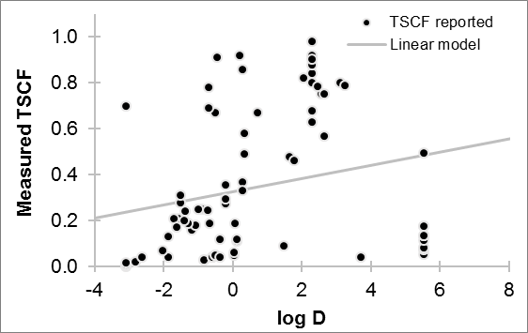
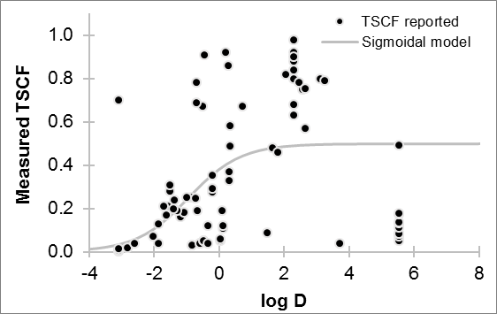
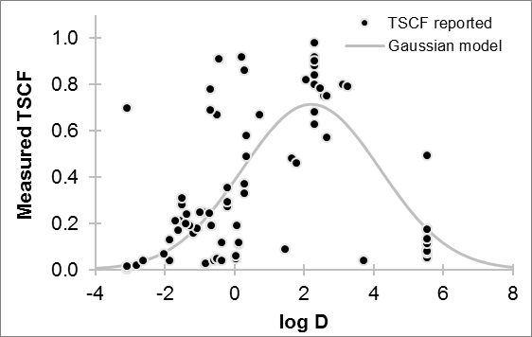
Identification of best-fit model Visual assessment, fit statistics
NSE: Nash-Sutcliff model efficiency, dimensionless goodness-of-fit indicator, rel. magnitude of residual variance compared to measured data variance, max. is 1
Linear
NSE = 0.05
Sigmoidal
NSE = 0.19
Gaussian
NSE = 0.47 / 57*
*: Two outliers removed prior to optimisation
Linear model overestimates TSCF observed for low and high log D
Sigmoidal model overestimates TSCF for high log D
All three models are better than arithmetic mean of TSCF (NSE > 0)
Gaussian model provides best description of TSCF training data set

Slide 8
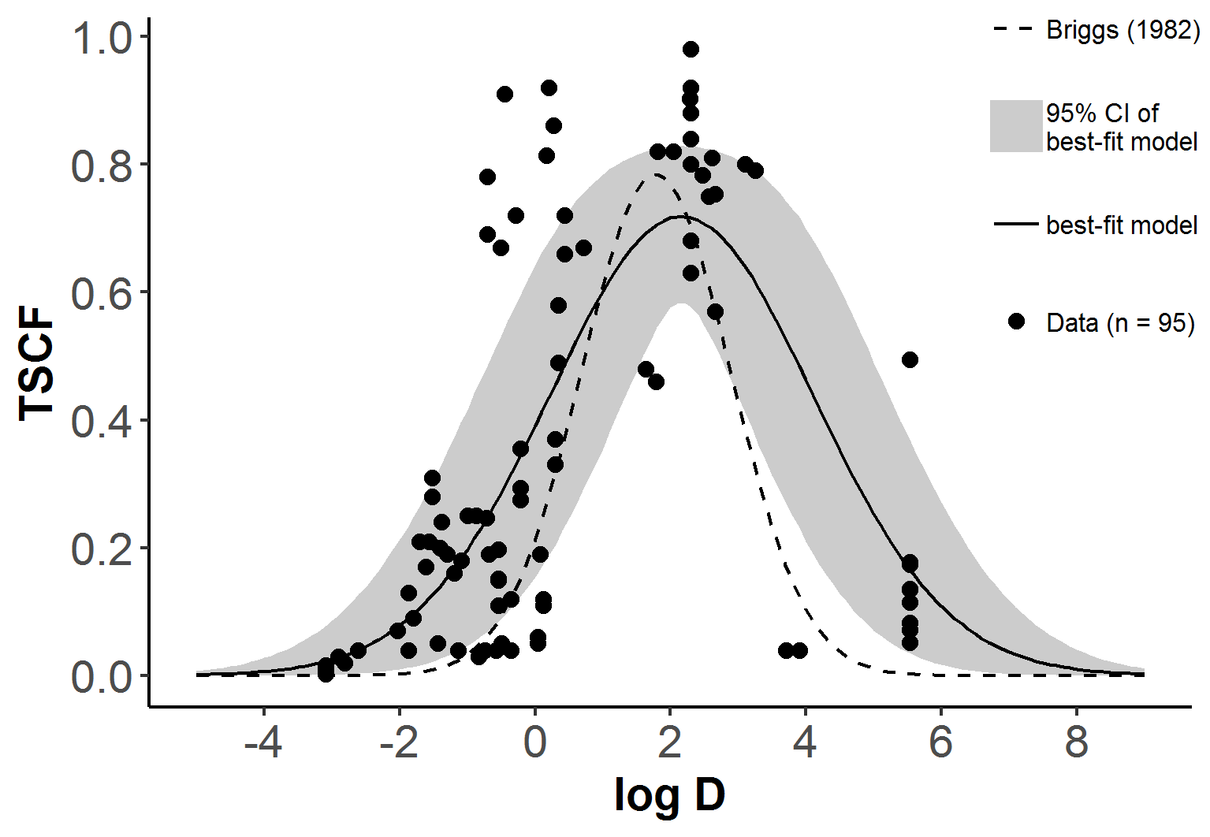
Model performance and conclusion
Test set: NSE = 0.58 → similar to training set without outlier
95% confidence interval of Gaussian model*
About 70% of training and test set are between lower and upper bound
Curve by Briggs et al. (1982) (non-ionisable compounds) overlaps or is below lower bound
Test set
*: Two outliers removed prior to optimisation
A log D based Gaussian model can be used to predict TSCF values for non-ionisable and ionisable compounds tested with intact plants.
Schriever, C., Lamshoeft, M., 2020. Lipophilicity matters – A new look at experimental plant uptake data from literature. Science of the Total Environment 713 (2020) 136667. https://doi.org/10.1016/j.scitotenv.2020.136667

Slide 9
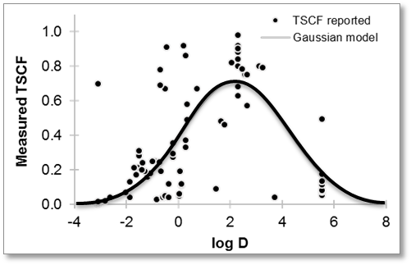
Outlook
What to do with the model?
E.g. predict TSCF values for refined environmental exposure modelling in the absence of experimental data
Measured log D (log Kow (pH) or Pow (pH) according to OECD 107/117)
Predicted log D (various software tools available)

